Slide 1
Helen Sharp, Yvonne Rogers, and Jenny Preece (2019)

Slide 2
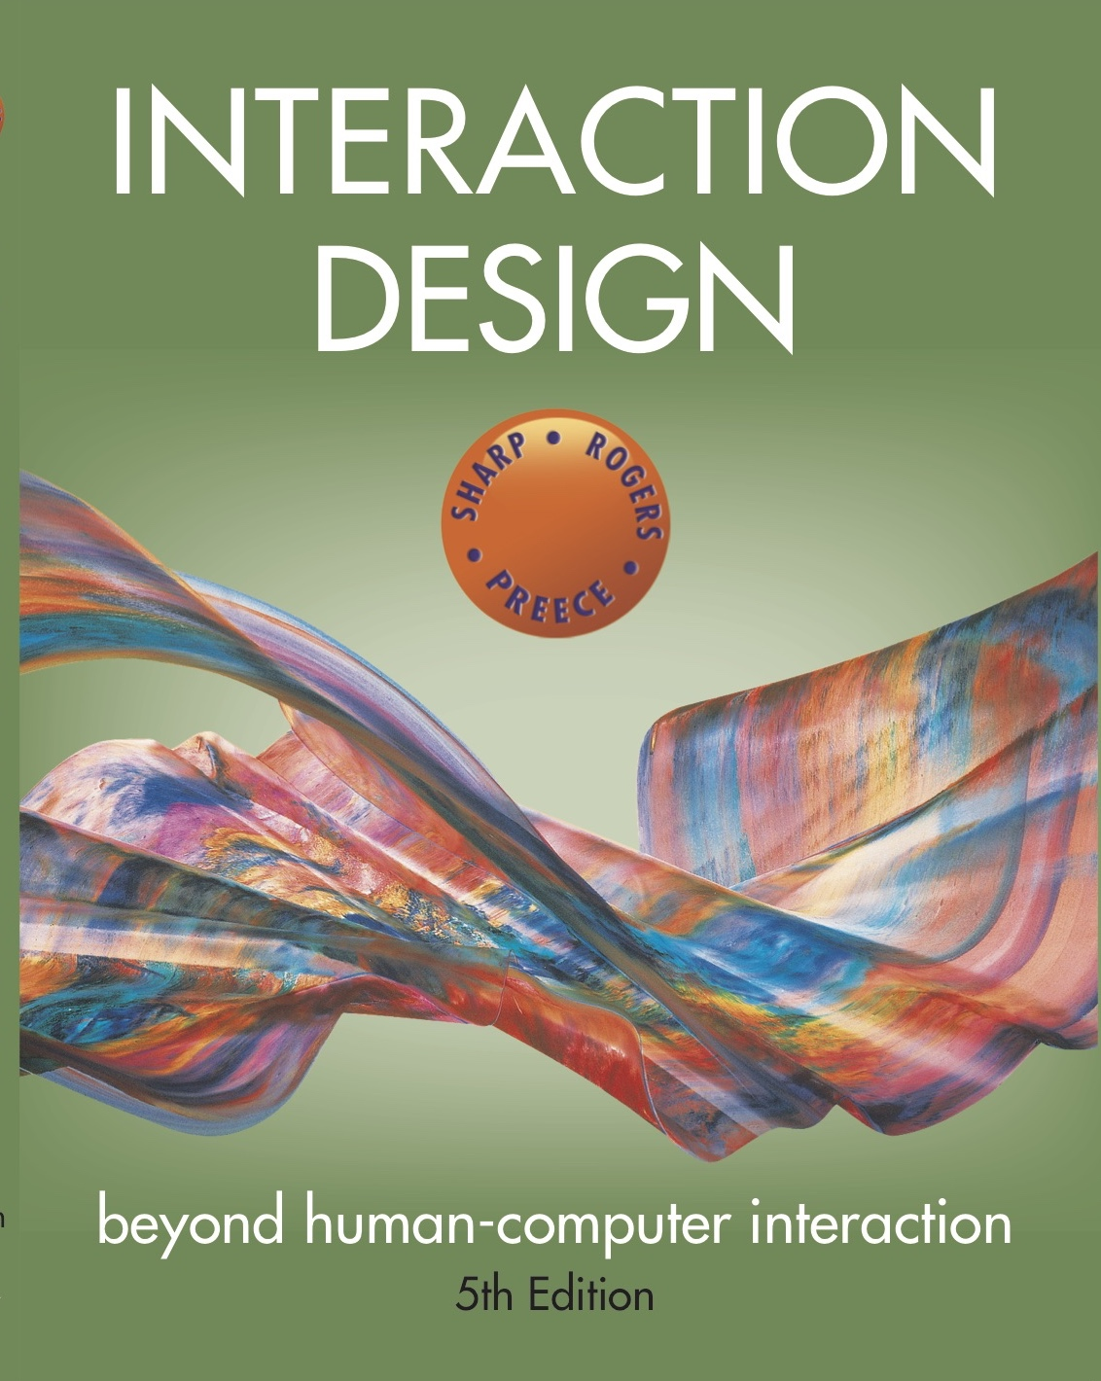
Chapter 1
WHAT IS INTERACTION DESIGN?

Slide 3
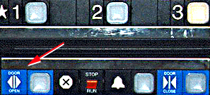
Bad designs
Elevator controls and labels on the bottom row all look the same, so it is easy to push a label by mistake instead of a control button.
People do not make same mistake for the labels and buttons on the top row. Why not?
www.baddesigns.com

Slide 4
Why is this vending machine so bad?
Need to push button first to activate reader
Normally insert bill first before making selection
Contravenes well known convention
www.baddesigns.com
4

Slide 5
Good design
Marble answering machine (Bishop, 1995)
Based on how everyday objects behave
Easy, intuitive, and a pleasure to use
Only requires one-step actions to perform core tasks
5

Slide 6
Good and bad design
Why is the TiVo remote much better designed than standard remote controls?
Peanut shaped to fit in hand
Logical layout and color-coded, distinctive buttons
Easy-to-locate buttons

Slide 7
Dilemma
Which is the best way to interact with a smart TV? Why?
Pecking using a grid keyboard via a remote control
Swiping across two alphanumeric rows using a touchpad on a remote control
Voice control using remote or smart speaker

Slide 8
What to design
Need to take into account:
Who the users are
What activities are being carried out
Where interaction is taking place
Need to optimize the interactions users have with a product:
So that they match the users’ activities and needs

Slide 9
What is interaction design?
“Designing interactive products to support the way people communicate and interact in their everyday and working lives.”
Sharp, Rogers, and Preece (2019)
“The design of spaces for human communication and interaction.”
Winograd (1997)

Slide 10
Goals of interaction design
Develop usable products
Usability means easy to learn, effective to use, and provides an enjoyable experience
Involve users in the design process

Slide 11
Which kind of design?
Number of other terms used emphasizing what is being designed, for example:
User interface design, software design, user-centered design, product design, web design, experience design (UX)
Interaction design is the umbrella term covering all of these aspects:
Fundamental to all disciplines, fields, and approaches concerned with researching and designing computer-based systems for people

Slide 12
Interaction design

Slide 13
Relationship between ID, HCI, and other fields−academic disciplines
Academic disciplines contributing to ID:
Psychology
Social Sciences
Computing Sciences
Engineering
Ergonomics
Informatics

Slide 14
Relationship between ID, HCI and other fields−design practices
Design practices contributing to ID:
Graphic design
Product design
Artist-design
Industrial design
Film industry

Slide 15
Relationship between ID, HCI and other fields−interdisciplinary fields
Interdisciplinary fields that ‘do’ interaction design:
HCI
Ubiquitous Computing
Human Factors
Cognitive Engineering
Cognitive Ergonomics
Computer Supported Co-operative Work
Information Systems

Slide 16
Working in multidisciplinary teams
Many people from different backgrounds involved
Different perspectives and ways of seeing and talking about things
Benefits
More ideas and designs generated
Disadvantages
Difficult to communicate and progress forward the designs being create

Slide 17
Interaction design in business
Large number of ID consultancies. Examples of well known ones include:
Nielsen Norman Group: “help companies enter the age of the consumer, designing human-centered products and services”
Cooper: “From research and product to goal-related design”
IDEO: “creates products, services and environments for companies pioneering new ways to provide value to their customers”

Slide 18
The user experience
How a product behaves and is used by people in the real world
The way people feel about it and their pleasure and satisfaction when using it, looking at it, holding it, and opening or closing it
“Every product that is used by someone has a user experience: newspapers, ketchup bottles, reclining armchairs, cardigan sweaters.” (Garrett, 2010)
“All aspects of the end-user's interaction with the company, its services, and its products. (Nielsen and Norman, 2014)
Cannot design a user experience−only can design for a user experience

Slide 19
Defining user experience
How users perceive a product, such as whether a smartwatch is seen as sleek or chunky, and their emotional reaction to it, such as whether people have a positive experience when using it.
(Hornbæk and Hertzum, 2017)
Hassenzahl’s (2010) model of the user experience
Pragmatic: how simple, practical, and obvious it is for the user to achieve their goals
Hedonic: how evocative and stimulating the interaction is to users

Slide 20
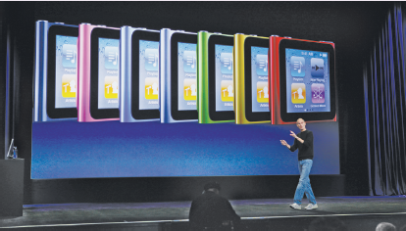
Why was the iPod user experience such a success?
Quality user experience from the start
Simple, elegant, distinct brand, pleasurable, must have fashion item, catchy names, cool...

Slide 21
Core characteristics of interaction design
Users should be involved throughout the development of the project
Specific usability and user experience goals need to be identified, clearly documented, and agreed to at the beginning of the project
Iteration is needed through the core activities

Slide 22
Why?
Help designers:
Understand how to design interactive products that fit with what people want, need, and may desire
Appreciate that one size does not fit all (for example, teenagers are very different to grown-ups)
Identify any incorrect assumptions they may have about particular user groups. (for example, not all old people want or need big fonts)
Be aware of both people’s sensitivities and their capabilities

Slide 23
Accessibility and inclusiveness
Accessibility: the extent to which an interactive product is accessible by as many people as possible
Focus is on people with disabilities; for instance, those using android OS or apple voiceover
Inclusiveness: making products and services that accommodate the widest possible number of people
For example, smartphones designed for all and made available to everyone regardless of their disability, education, age, or income

Slide 24
Disabilities
Whether someone is disabled changes over time with age, or recovery from an accident
The severity and impact of an impairment can vary over the course of a day or in different environmental conditions
Disabilities can result because technologies are designed to necessitate a certain type of interaction that is impossible for someone with an impairment

Slide 25
Understanding disability
Disabilities can be classified as:
Sensory impairment (such as loss of vision or hearing)
Physical impairment (having loss of functions to one or more parts of the body after a stroke or spinal cord injury)
Cognitive (including learning impairment or loss of memory/cognitive function due to old age)
Each type can be further defined in terms of capability:
For example, someone might have only peripheral vision, be color blind, or have no light perception
Impairment can be categorized:
Permanent (for instance, long-term wheelchair user)
Temporary (that is, after an accident or illness)
Situational (for example, a noisy environment means that a person can’t hear)

Slide 26
Being cool about disability
Prosthetics can be designed to move beyond being functional (and often ugly) to being desirable and fashionable
People now refer to “wearing their wheels,” rather than “using a wheelchair”
Fashionable leg cover designed by Alleles Design Studio

Slide 27
Cultural differences
5/21/2015 versus 21/5/2015?
Which should be used for international services and online forms?
Why is it that certain products, like smartphones, are universally accepted by people from all parts of the world, whereas people from different cultures react to websites differently?

Slide 28
Usability goals
Effective to use
Efficient to use
Safe to use
Have good utility
Easy to learn
Easy to remember how to use

Slide 29
Usability and user experience goals
Selecting terms to convey a person’s feelings, emotions, and so forth can help designers understand the multifaceted nature of the user experience
How do usability goals differ from user experience goals?
Are there trade-offs between the two kinds of goals? (for example, can a product be both fun and safe?)
How easy is it to measure usability versus user experience goals?

Slide 30
User experience goals
Desirable aspects
Satisfying Helpful Fun
Enjoyable Motivating Provocative
Engaging Challenging Surprising
Pleasurable Enhancing sociability Rewarding
Exciting Supporting creativity Emotionally fulfilling
Entertaining Cognitively stimulating Experiencing flow
Undesirable aspects
Boring Unpleasant
Frustrating Patronizing
Making one feel guilty Making one feel stupid
Annoying Cutesy
Childish Gimmicky

Slide 31
Design principles
Generalizable abstractions for thinking about different aspects of design
The do’s and don'ts of interaction design
What to provide and what not to provide at the interface
Derived from a mix of theory-based knowledge, experience, and common-sense

Slide 32
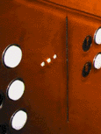
Visibility - poor interface
• This is a control panel for an elevator
• How does it work?
• Push a button for the floor you want?
• Nothing happens. Push any other button? Still nothing. What do you need to do?
It is not visible as to what to do!
www.baddesigns.com

Slide 33
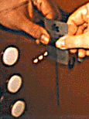
Visibility - Improving on a poor interface
…with this elevator, you need to insert your room card in the slot by the buttons to get the elevator to work!
How would you make this action more visible?
• Make the card reader more obvious
• Provide an auditory message that says what to do (which language?)
• Provide a big label next to the card reader that flashes when someone enters
• Make relevant parts visible
• Make what has to be done obvious
www.baddesigns.com

Slide 34
What do I do if I am wearing black?
Invisible automatic controls can make it more difficult to use

Slide 35
Feedback
Sending information back to the user about what has been done
Includes sound, highlighting, animation, and combinations of these
For example, when screen button is clicked, it provides sound or red highlight feedback:
“ccclichhk”

Slide 36
Constraints
Restricting the possible actions that can be performed
Helps prevent user from selecting incorrect options
Physical objects can be designed to constrain things. (for example, there being only one way you can insert a key into a lock)

Slide 37
Logical or ambiguous design?
Where do you plug the mouse?
Where do you plug the keyboard, in the top or bottom connector?
Do the color-coded icons help?
www.baddesigns.com

Slide 38
How to design them more logically
(A) provides direct adjacent mapping between icon and connector
(B) provides color coding that associates the connectors with the labels
www.baddesigns.com
www.baddesigns.com

Slide 39
Consistency
Design interfaces to have similar operations and use similar elements for similar tasks. (for example, always use Ctrl key plus first initial of the command for an operation: Ctrl+c, Ctrl+s, Ctrl+o)
The main benefit is that consistent interfaces are easier to learn and use

Slide 40
When consistency breaks down
What happens if there is more than one command starting with the same letter? (for example, save, spelling, select, style)
You have to find other initials or combinations of keys, thereby breaking the consistency rule (for example, Ctrl+s, Ctrl+Sp, Ctrl+shift+l)
Increases learning burden on user, making them more prone to errors

Slide 41
Internal and external consistency
Internal consistency refers to designing operations to behave the same within an application
Difficult to achieve with complex interfaces
External consistency refers to designing operations, interfaces, and so on to be the same across applications and devices
Very rarely the case, based on different designer’s preference

Slide 42
Keypad numbers layout
A case of external inconsistency
(a) phones, remote controls
(b) calculators, computer keypads
1
2
3
7
8
9
4
5
6
4
5
6
7
8
9
1
2
3
0
0

Slide 43
Affordances: to give a clue
Refers to an attribute of an object that allows people to know how to use it. (For example, a mouse button invites pushing, a door handle affords pulling)
Norman (1988) used the term to discuss the design of everyday objects
Has since been popularized in interaction design to discuss how to design interface objects (for example, scrollbars to enable moving up and down; icons to click on)

Slide 44
What does “affordance” have to offer interaction design?
Interfaces are virtual and do not have affordances like physical objects
Norman argues that it does not make sense to talk about interfaces in terms of ‘real’ affordances
Instead, interfaces are better conceptualized as ‘perceived’ affordances:
Learned conventions of arbitrary mappings between action and effect at the interface
Some mappings are better than others

Slide 45
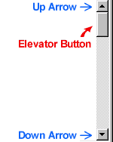
Activity
Virtual affordances
How do these screen objects afford?
What if you were a novice user?
Would you know what to do with them?

Slide 46
Key points
Interaction design is concerned with designing interactive products to support how people communicate and interact in their everyday and working lives
It is concerned with how to create quality user experiences for services, devices, and interactive products
It is multidisciplinary, involving many inputs from wide-reaching disciplines and fields
Optimizing the interaction between users and interactive products requires consideration of a number of interdependent factors, including context of use, types of activity, UX goals, accessibility, cultural differences, and user groups.
Design principles, such as feedback and simplicity, are useful heuristics for informing, analyzing, and evaluating aspects of an interactive product.

