Slide 1

Chapter 9
THE PROCESS OF INTERACTION DESIGN

Slide 2
Overview
What is involved in Interaction Design?
  Importance of involving users
  Degrees of user involvement
  What is a user-centered approach?
  Four basic activities
Some practical issues
  Who are the users?
  What are ‘needs’?
  Where do alternatives come from?
  How to choose among alternatives?
  How to integrate interaction design activities in other lifecycle models?

Slide 3
What is involved in Interaction Design?
It is a process:
  a goal-directed problem solving activity informed by intended use, target domain, materials, cost, and feasibility
  a creative activity
  a decision-making activity to balance trade-offs
Generating alternatives and choosing between them is key
Four approaches: user-centered design, activity-centered design, systems design, and genius design

Slide 4
Importance of involving users
Expectation management
  Realistic expectations
  No surprises, no disappointments
  Timely training
  Communication, but no hype
Ownership
  Make the users active stakeholders
  More likely to forgive or accept problems
  Can make a big difference to acceptance and success of product

Slide 5
Degrees of user involvement
Member of the design team
  Full time: constant input, but lose touch with users
  Part time: patchy input, and very stressful
  Short term: inconsistent across project life
  Long term: consistent, but lose touch with users
Newsletters and other dissemination devices
  Reach wider selection of users
  Need communication both ways
User involvement after product is released
Combination of these approaches

Slide 6
What is a user-centered approach?
User-centered approach is based on:
  Early focus on users and tasks: directly studying cognitive, behavioral, anthropomorphic & attitudinal characteristics
  Empirical measurement: users’ reactions and performance to scenarios, manuals, simulations & prototypes are observed, recorded and analysed
  Iterative design: when problems are found in user testing, fix them and carry out more tests

Slide 7
Four basic activities in Interaction Design
  Establishing requirements
  Designing alternatives
  Prototyping
  Evaluating

Slide 8
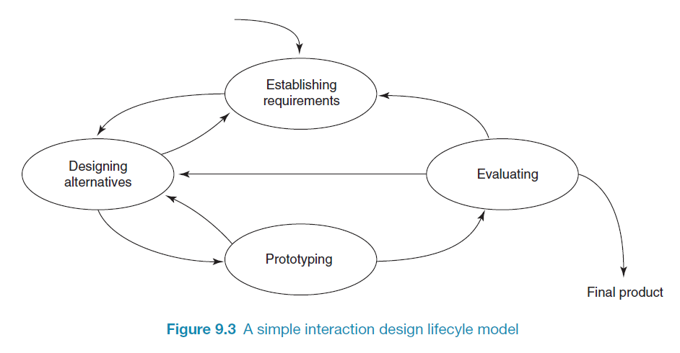
A simple interaction design lifecycle model
Exemplifies a user-centered design approach

Slide 9
Some practical issues
Who are the users?
What do we mean by ‘needs’?
How to generate alternatives
How to choose among alternatives
How to integrate interaction design activities with other lifecycle models?

Slide 10
Who are the users/stakeholders?
Not as obvious as you think:
  those who interact directly with the product
  those who manage direct users
  those who receive output from the product
  those who make the purchasing decision
  those who use competitor’s products
Three categories of user (Eason, 1987):
  primary: frequent hands-on
  secondary: occasional or via someone else
  tertiary: affected by its introduction, or will influence its purchase

Slide 11
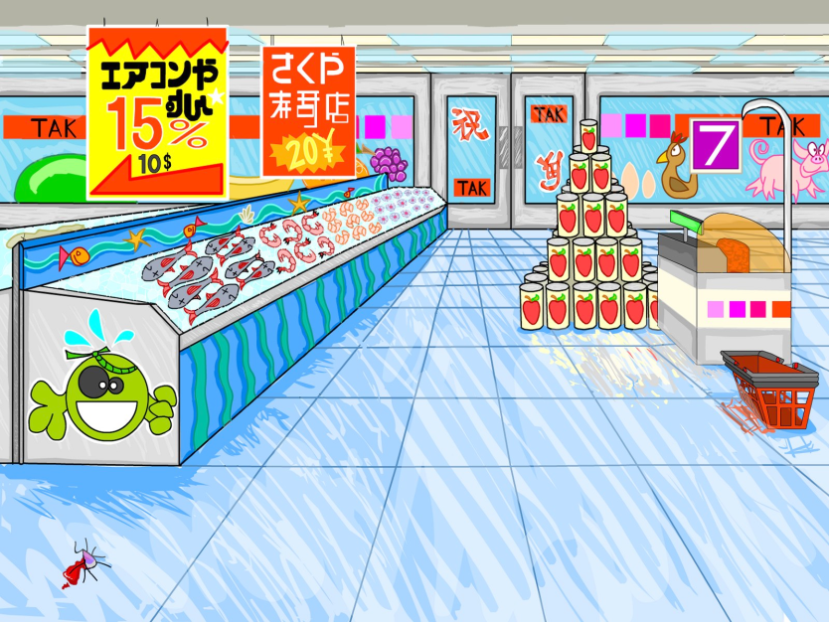
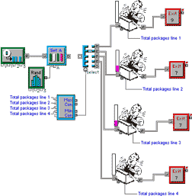

Who are the stakeholders?
Check-out operators
• Suppliers
• Local shop
owners
Customers
Managers and owners

Slide 12
What do we mean by ‘needs’?
Users rarely know what is possible
Users can’t tell you what they ‘need’ to help them achieve their goals
Instead, look at existing tasks:
  their context
  what information do they require?
  who collaborates to achieve the task?
  why is the task achieved the way it is?
Envisioned tasks:
  can be rooted in existing behaviour
  can be described as future scenarios

Slide 13
How to generate alternatives
Humans stick to what they know works
But considering alternatives is important to ‘break out of the box’
Designers are trained to consider alternatives, software people generally are not
How do you generate alternatives?
  ‘Flair and creativity’: research and synthesis
  Seek inspiration: look at similar products or look at very different products

Slide 14
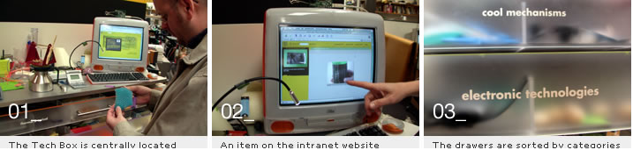
IDEO TechBox
Library, database and website all-in-one
Contains physical gizmos for inspiration

Slide 15
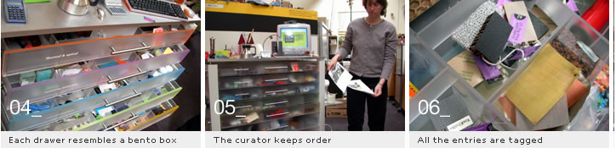
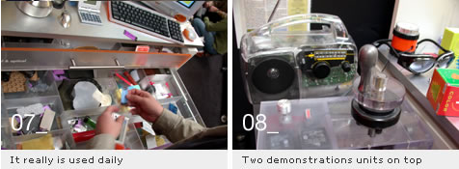
The TechBox

Slide 16
How to choose among alternatives
Evaluation with users or with peers, e.g. prototypes
Technical feasibility: some not possible
Quality thresholds: Usability goals lead to usability criteria set early on and check regularly
  safety: how safe?
  utility: which functions are superfluous?
  effectiveness: appropriate support? task coverage, information available
  efficiency: performance measurements
  learnability: is the time taken to learn a function acceptable to the users?
  memorability: can infrequent users remember how to achieve their goal?

Slide 17
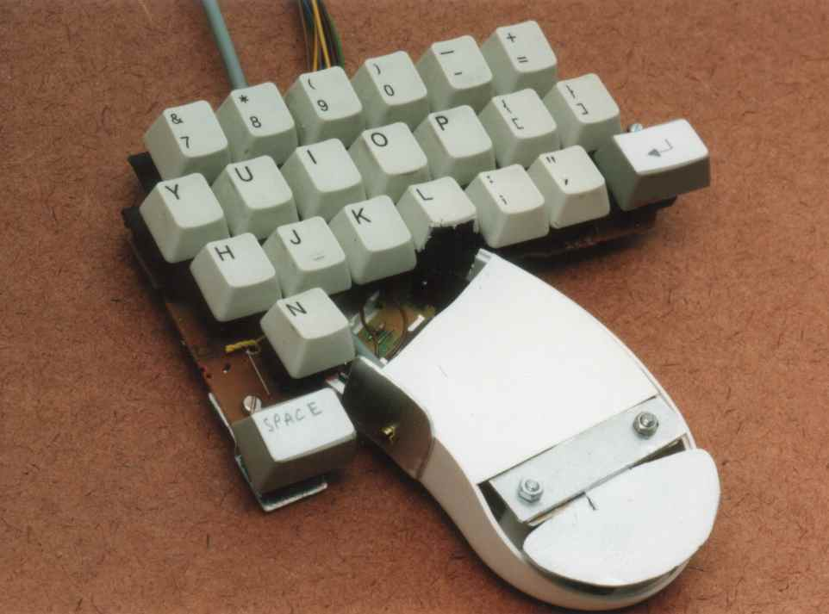
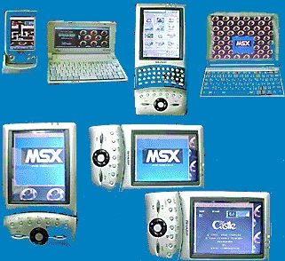
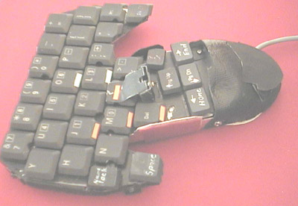
Testing prototypes to choose among alternatives

Slide 18
How to integrate interaction design in other models
Integrating interaction design activities in lifecycle models from other disciplines needs careful planning
Several software engineering lifecycle models have been considered
Integrating with agile software development is promising
  it stresses the importance of iteration
  it champions early and regular feedback
  it handles emergent requirements
  it aims to strike a balance between flexibility and structure

Slide 19
Summary
Four basic activities in the design process
  Establishing requirements
  Designing alternatives
  Prototyping
  Evaluating
User-centered design rests on three principles
  Early focus on users and tasks
  Empirical measurement using quantifiable & measurable usability criteria
  Iterative design

