Slide 1
Shareable interfaces
Shareable interfaces are designed for more than one person to use
  provide multiple inputs and sometimes allow simultaneous input by co-located groups
  large wall displays where people use their own pens or gestures
  interactive tabletops where small groups interact with information using their fingertips, e.g., Mitsubishi’s DiamondTouch and Sony’s Smartskin

Slide 2
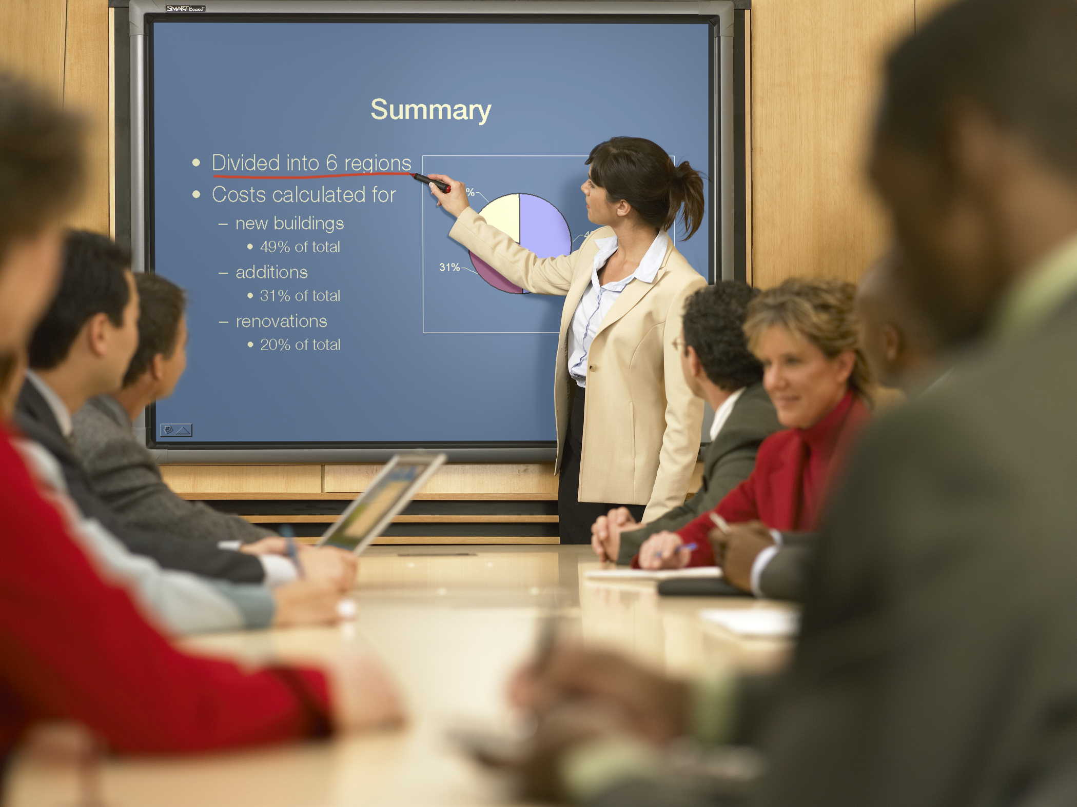
A smartboard

Slide 3
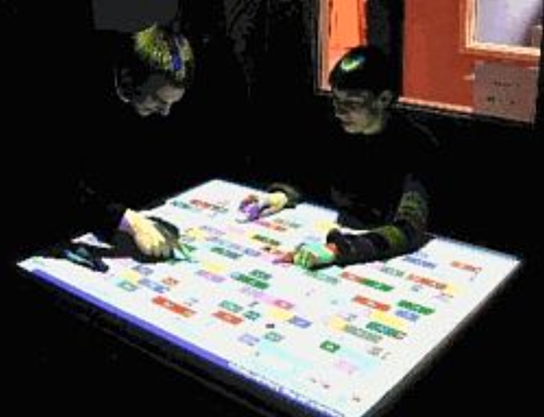
DiamondTouch Tabletop

Slide 4
Advantages
Provide a large interactional space that can support flexible group working
Can be used by multiple users
  can point to and touch information being displayed
  simultaneously view the interactions and have same shared point of reference as others
Can support more equitable participation compared with groups using single PC

Slide 5
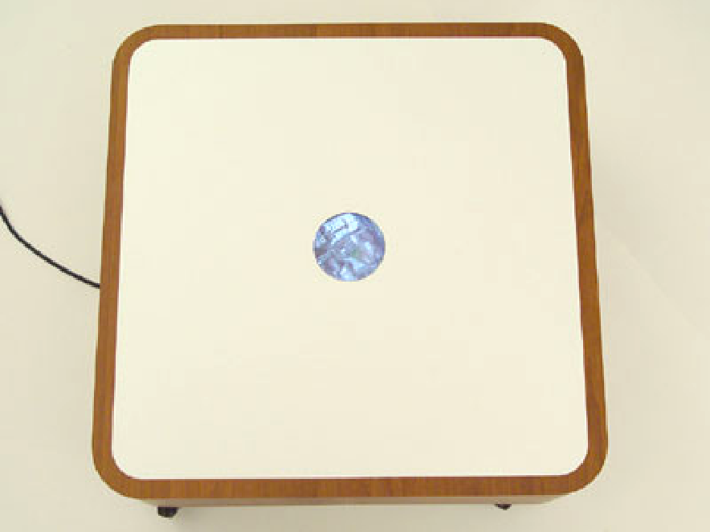
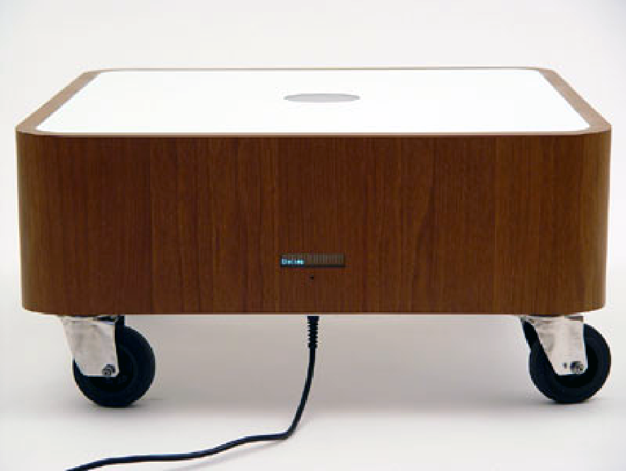
The Drift Table

Slide 6
Research and design issues
More fluid and direct styles of interaction involving freehand and pen-based gestures
Core design concerns include whether size, orientation, and shape of the display have an effect on collaboration
horizontal surfaces compared with vertical ones support more turn-taking and collaborative working in co-located groups
Providing larger-sized tabletops does not improve group working but encourages more division of labor

Slide 7
Tangible interfaces
Type of sensor-based interaction, where physical objects, e.g., bricks, are coupled with digital representations
When a person manipulates the physical object/s it causes a digital effect to occur, e.g. an animation
Digital effects can take place in a number of media and places or can be embedded in the physical object

Slide 8
Examples
Chromarium cubes
  when turned over digital animations of color are mixed on an adjacent wall
  faciliates creativity and collaborative exploration
Flow Blocks
  depict changing numbers and lights embedded in the blocks
  vary depending on how they are connected together
Urp
  physical models of buildings moved around on tabletop
  used in combination with tokens for wind and shadows -> digital shadows surrounding them to change over time

Slide 9
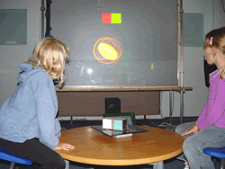
Chromarium cubes

Slide 10
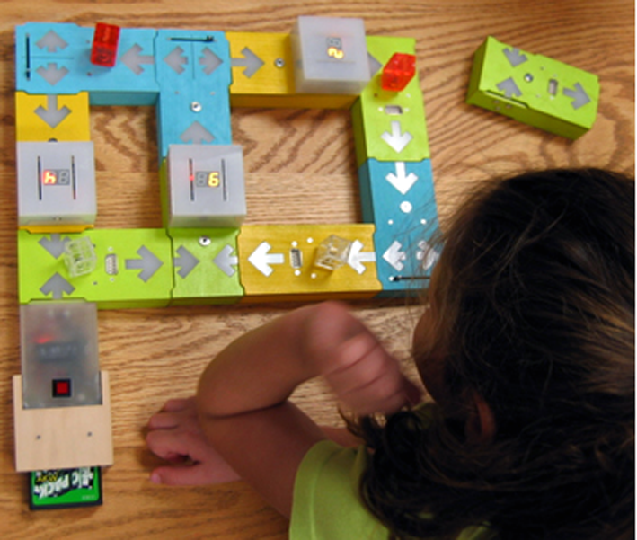
Flow blocks

Slide 11
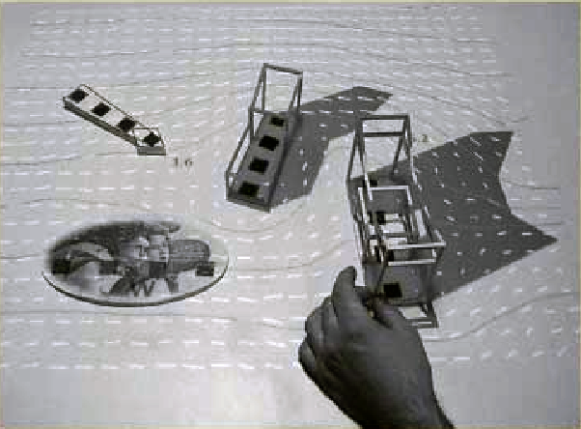
Urp

Slide 12
Benefits
Can be held in both hands and combined and manipulated in ways not possible using other interfaces
  allows for more than one person to explore the interface together
  objects can be placed on top of each other, beside each other, and inside each other
  encourages different ways of representing and exploring a problem space
People are able to see and understand situations differently
  can lead to greater insight, learning, and problem-solving than with other kinds of interfaces
  can facilitate creativity and reflection

Slide 13
Research and design issues
Develop new conceptual frameworks that identify novel and specific features
The kind of coupling to use between the physical action and digital effect
  If it is to support learning then an explicit mapping between action and effect is critical
  If it is for entertainment then can be better to design it to be more implicit and unexpected
What kind of physical artifact to use
  Bricks, cubes, and other component sets are most commonly used because of flexibility and simplicity
  Stickies and cardboard tokens can also be used for placing material onto a surface

Slide 14
Wearable interfaces
First developments was head- and eyewear-mounted cameras that enabled user to record what seen and to access digital information
Since, jewelery, head-mounted caps, smart fabrics, glasses, shoes, and jackets have all been used
  provide the user with a means of interacting with digital information while on the move
Applications include automatic diaries and tour guides

Slide 15
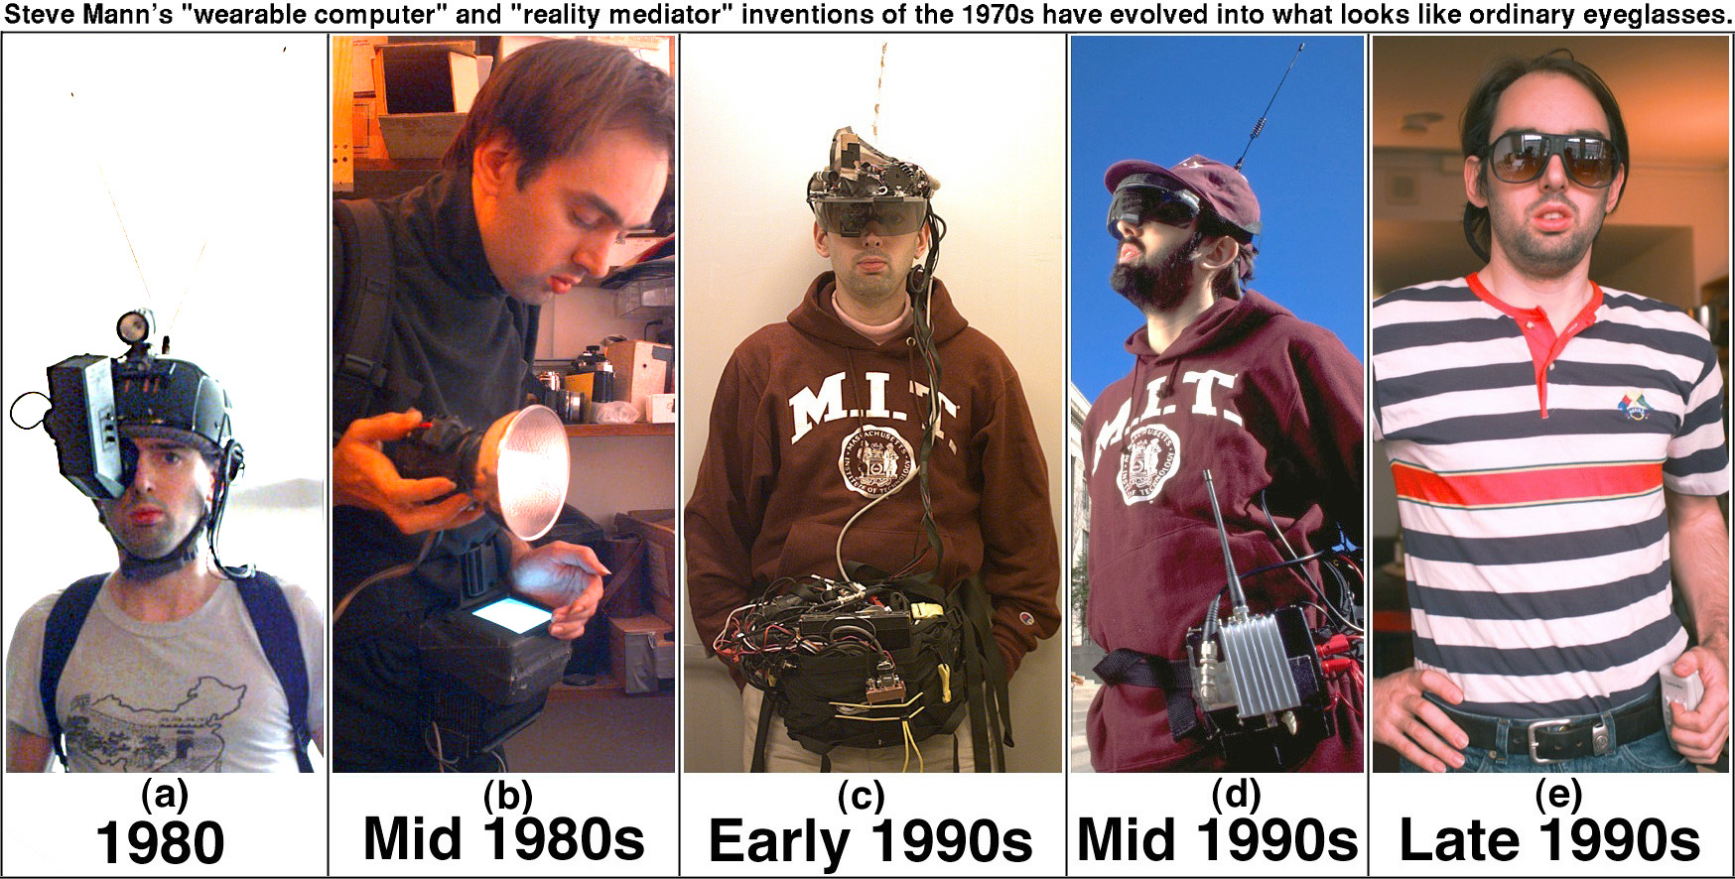
Steve Mann - pioneer of wearables

Slide 16
Research and design issues
Comfort
  needs to be light, small, not get in the way, fashionable, and preferably hidden in the clothing
Hygiene
  is it possible to wash or clean the clothing once worn?
Ease of wear
  how easy is it to remove the electronic gadgetry and replace it?
Usability
  how does the user control the devices that are embedded in the clothing?

Slide 17
Robotic interfaces
Four types
  remote robots used in hazardous settings
  domestic robots helping around the house
  pet robots as human companions
  sociable robots that work collaboratively with humans, and communicate and socialize with them – as if they were our peers

Slide 18
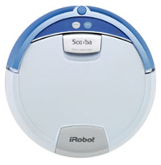
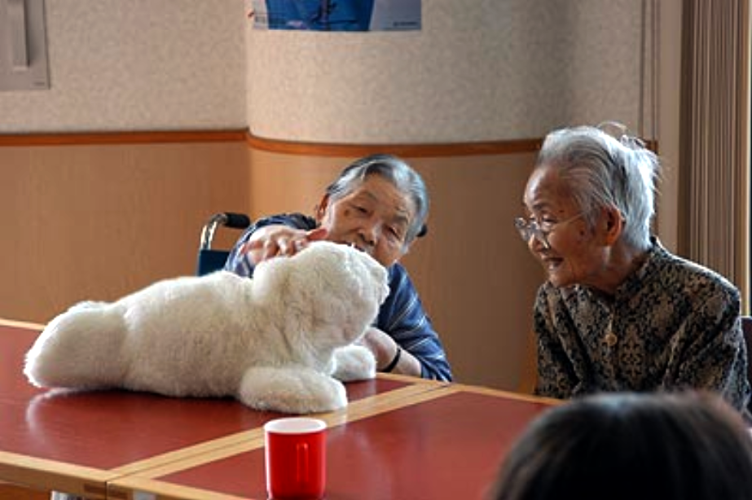
Advantages
Pet robots have therapeutic qualities, being able to reduce stress and loneliness
Remote robots can be controlled to investigate bombs and other dangerous materials

Slide 19
Research and design issues
How do humans react to physical robots designed to exhibit behaviors (e.g., making facial expressions) compared with virtual ones?
Should robots be designed to be human-like or look like and behave like robots that serve a clearly defined purpose?
Should the interaction be designed to enable people to interact with the robot as if it was another human being or more human-computer-like (e.g., pressing buttons to issue commands)?

Slide 20
Which interface?
Is multimedia better than tangible interfaces for learning?
Is speech as effective as a command-based interface?
Is a multimodal interface more effective than a monomodal interface?
Will wearable interfaces be better than mobile interfaces for helping people find information in foreign cities?
Are virtual environments the ultimate interface for playing games?
Will shareable interfaces be better at supporting communication and collaboration compared with using networked desktop PCs?

Slide 21
Which interface?
Will depend on task, users, context, cost, robustness, etc.
Much system development will continue for the PC platform, using advanced GUIs, in the form of multimedia, web-based interfaces, and virtual 3D environments
  Mobile interfaces have come of age
  Increasing number of applications and software toolkits available
  Speech interfaces also being used much more for a variety of commercial services
  Appliance and vehicle interfaces becoming more important
  Shareable and tangible interfaces entering our homes, schools, public places, and workplaces

Slide 22
Summary
Many innovative interfaces have emerged post the WIMP/GUI era, including speech, wearable, mobile, and tangible
Many new design and research questions need to be considered to decide which one to use
Web interfaces are becoming more like multimedia-based interfaces
An important concern that underlies the design of any kind of interface is how information is represented to the user so they can carry out ongoing activity or task

