Slide 1
Chapter 6
_{Interfaces}

Slide 2
Overview
Interface types
  highlight the main design and research issues for each of the different interfaces
Consider which interface is best for a given application or activity
Notes:
2

Slide 3
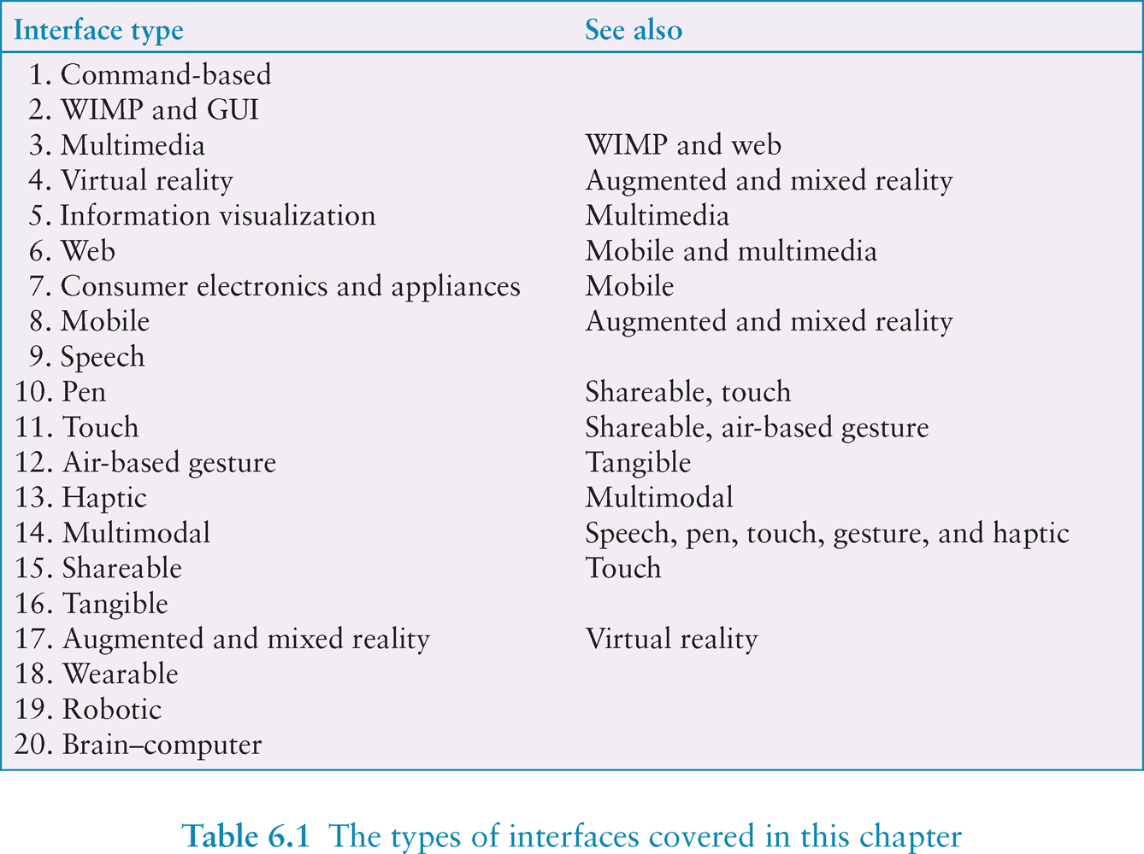
Notes:
3
There is now a diversity of interfaces. The goal of this chapter is to consider how to design interfaces for different environments, people, places, and activities. We present a catalog of 20 interface types, starting with command-based and ending with brain-computer. For each one, we present an overview and outline the key research and design concerns. Some are only briefly touched upon while others – that are more established in interaction design – are described in more depth.
Numerous adjectives have been used to describe the different kinds of interfaces that have been developed, including graphical, command, speech, multimodal, invisible, ambient, mobile, intelligent, adaptive, tangible, touchless and natural. Some of the interface types are primarily concerned with a function (e.g. to be intelligent, to be adaptive, to be ambient), while others focus on the interaction style used (e.g. command, graphical, multimedia), the input/output device used (e.g. pen-based, speech-based), or the platform being designed for (e.g. PC, mobile, tabletop). The interface types are loosely ordered in terms of when they were developed. They are numbered to make it easier to find a particular one (see Table 6.1 for complete set). It should be noted, however, that this classification is for convenience. The interface entries are not mutually exclusive since some products can appear in two categories. For example, a smartphone can be considered to be either mobile or touch. Table 6.1 suggests which interfaces are related or have design issues in common.

Slide 4
1. Command-based
Commands such as abbreviations (e.g. ls) typed in at the prompt to which the system responds (e.g. listing current files)
Some are hard wired at keyboard, others can be assigned to keys
Efficient, precise, and fast
Large overhead to learning set of commands
Notes:
4

Slide 5
Second Life command-based interface for visually impaired users

Slide 6

Research and design issues
Form, name types and structure are key research questions
Consistency is most important design principle
  e.g. always use first letter of command
Command interfaces popular for web scripting
Notes:
6

Slide 7
2. WIMP and GUI
Xerox Star first WIMP -> rise to GUIs
Windows
  could be scrolled, stretched, overlapped, opened, closed, and moved around the screen using the mouse
Icons
  represented applications, objects, commands, and tools that were opened when clicked on
Menus
  offering lists of options that could be scrolled through and selected
Pointing device
  a mouse controlling the cursor as a point of entry to the windows, menus, and icons on the screen
Notes:
7

Slide 8
GUIs
Same basic building blocks as WIMPs but more varied
  Color, 3D, sound, animation,
  Many types of menus, icons, windows
New graphical elements, e.g.
  toolbars, docks, rollovers
Notes:
8

Slide 9
Windows
Windows were invented to overcome physical constraints of a computer display
  enable more information to be viewed and tasks to be performed
Scroll bars within windows also enable more information to be viewed
Multiple windows can make it difficult to find desired one
  listing, iconising, shrinking are techniques that help
Notes:
9

Slide 10
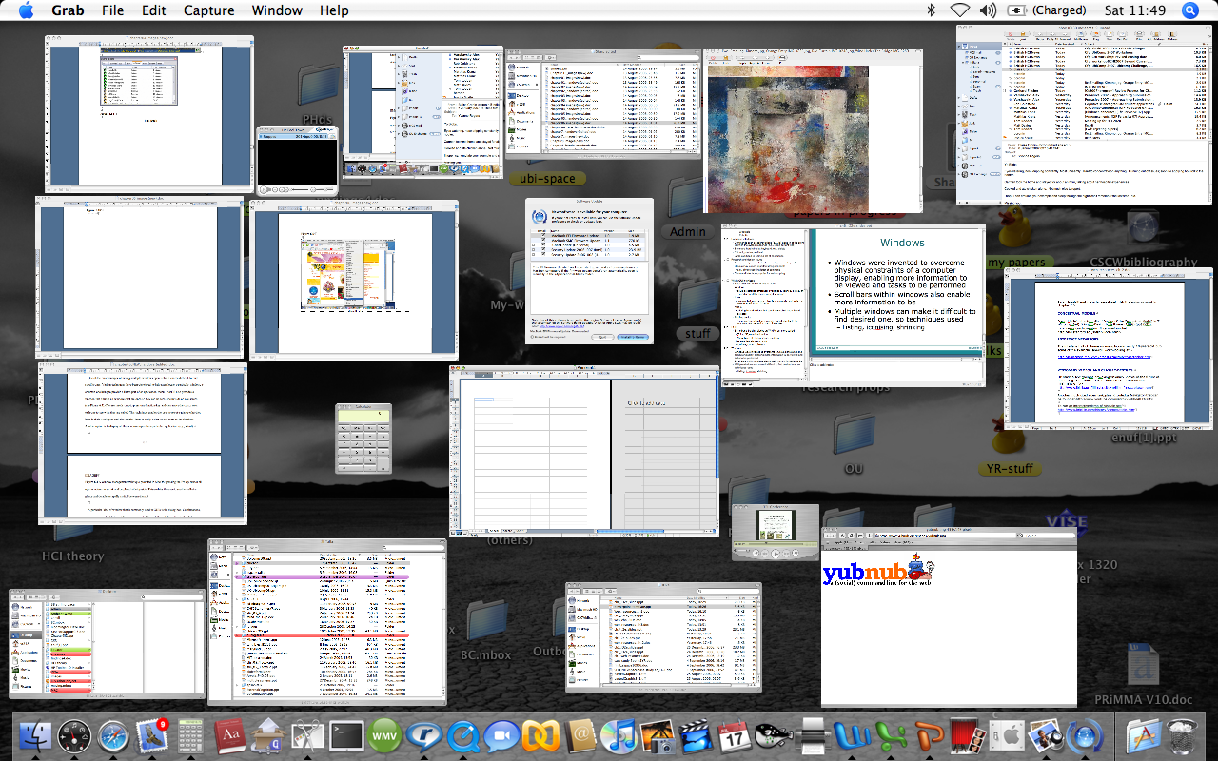
Apple’s shrinking windows
Notes:
10

Slide 11
Safari panorama window view

Slide 12
Selecting a country from a scrolling window
Notes:
12

Slide 13
Is this method any better?
Notes:
13

Slide 14
Research and design issues
Window management
  enables users to move fluidly between different windows (and monitors)
How to switch attention between windows without getting distracted
Design principles of spacing, grouping, and simplicity should be used
Notes:
14

Slide 15
Menus
A number of menu interface styles
  flat lists, drop-down, pop-up, contextual, and expanding ones, e.g., scrolling and cascading
Flat menus
  good at displaying a small number of options at the same time and where the size of the display is small, e.g. iPods
  but have to nest the lists of options within each other, requiring several steps to get to the list with the desired option
  moving through previous screens can be tedious
Notes:
15

Slide 16
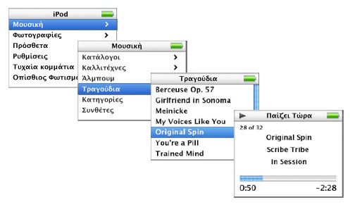
iPod flat menu structure
www.rainbow.gr/images/ rainbow/news/press/menu.jpg
A sequence of options selected shown in the 4 windows
Notes:
16

Slide 17
Expanding menus
Enables more options to be shown on a single screen than is possible with a single flat menu
More flexible navigation, allowing for selection of options to be done in the same window
Most popular are cascading ones
  primary, secondary and even tertiary menus
  downside is that they require precise mouse control
  can result in overshooting or selecting wrong options
Notes:
17

Slide 18
Cascading menu
Notes:
18

Slide 19
Contextual menus
Provide access to often-used commands that make sense in the context of a current task
Appear when the user presses the Control key while clicking on an interface element
  e.g., clicking on a photo in a website together with holding down the Control key results in options ‘open it in a new window,’ ‘save it,’ or ‘copy it’
Helps overcome some of the navigation problems associated with cascading menus
Notes:
19

Slide 20
Windows Jump List Menu

Slide 21
Research and design issues
What are best names/labels/phrases to use?
Placement in list is critical
  Quit and save need to be far apart
Many international guidelines exist emphasizing depth/breadth, structure and navigation
  e.g. ISO 9241
Notes:
21

Slide 22
Icon design
Icons are assumed to be easier to learn and remember than commands
Can be designed to be compact and variably positioned on a screen
Now pervasive in every interface
  e.g. represent desktop objects, tools (e.g. paintbrush), applications (e.g. web browser), and operations (e.g. cut, paste, next, accept, change)
Notes:
22

Slide 23
Icons
Since the Xerox Star days icons have changed in their look and feel:
  black and white -> color, shadowing, photorealistic images, 3D rendering, and animation
Many designed to be very detailed and animated making them both visually attractive and informative
GUIs now highly inviting, emotionally appealing, and feel alive
Notes:
23

Slide 24
Icon forms
The mapping between the representation and underlying referent can be:
  similar (e.g., a picture of a file to represent the object file),
  analogical (e.g., a picture of a pair of scissors to represent ‘cut’)
  arbitrary (e.g., the use of an X to represent ‘delete’)
Most effective icons are similar ones
Many operations are actions making it more difficult to represent them
  use a combination of objects and symbols that capture the salient part of an action
Notes:
24

Slide 25
Early icons
Notes:
25

Slide 26
Newer icons
Notes:
26

Slide 27
Simple icons plus labels
Notes:
27

Slide 28
Activity
Sketch simple icons to represent the operations to appear on a digital camera LCD screen:
  Delete last picture taken
  Delete all pictures stored
  Format memory card
Notes:
28

Slide 29
Toshiba’s icons
Which is which?
Are they easy to understand
Are they distinguishable?
What representation forms
are used?
How do yours compare?
Notes:
29

Slide 30
Research and design issues
There is a wealth of resources now so do not have to draw or invent new icons from scratch
  guidelines, style guides, icon builders, libraries
Text labels can be used alongside icons to help identification for small icon sets
For large icon sets (e.g. photo editing or word processing) use rollovers
Notes:
30

Slide 31
3. Multimedia
Combines different media within a single interface with various forms of interactivity
  graphics, text, video, sound, and animations
Users click on links in an image or text
-> another part of the program
-> an animation or a video clip is played
->can return to where they were or move on to another place
Notes:
31

Slide 32
BioBlast multimedia learning environment
Notes:
32

Slide 33
Pros and cons
Facilitates rapid access to multiple representations of information
Can provide better ways of presenting information than can any media alone
Can enable easier learning, better understanding, more engagement, and more pleasure
Can encourage users to explore different parts of a game or story
Tendency to play video clips and animations, while skimming through accompanying text or diagrams
Notes:
33

Slide 34
Research and design issues
How to design multimedia to help users explore, keep track of, and integrate the multiple representations
  provide hands-on interactivities and simulations that the user has to complete to solve a task
  Use ‘dynalinking,’ where information depicted in one window explicitly changes in relation to what happens in another (Scaife and Rogers, 1996).
Several guidelines that recommend how to combine multiple media for different kinds of task
Notes:
34

Slide 35
4. Virtual reality
Computer-generated graphical simulations providing:
  “the illusion of participation in a synthetic environment rather than external observation of such an environment” (Gigante, 1993)
provide new kinds of experience, enabling users to interact with objects and navigate in 3D space
Create highly engaging user experiences
Notes:
35

Slide 36
Pros and cons
Can have a higher level of fidelity with objects they represent compared to multimedia
Induces a sense of presence where someone is totally engrossed by the experience
  “a state of consciousness, the (psychological) sense of being in the virtual environment” (Slater and Wilbur, 1999)
Provides different viewpoints: 1st and 3rd person
Head-mounted displays are uncomfortable to wear, and can cause motion sickness and disorientation
Notes:
36

Slide 37
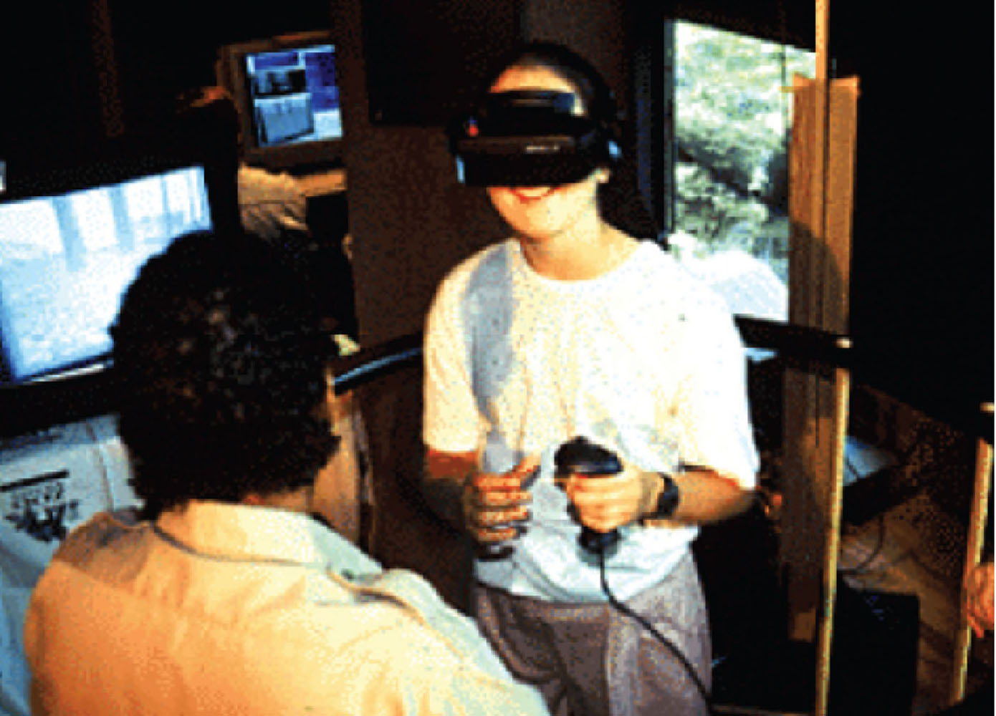
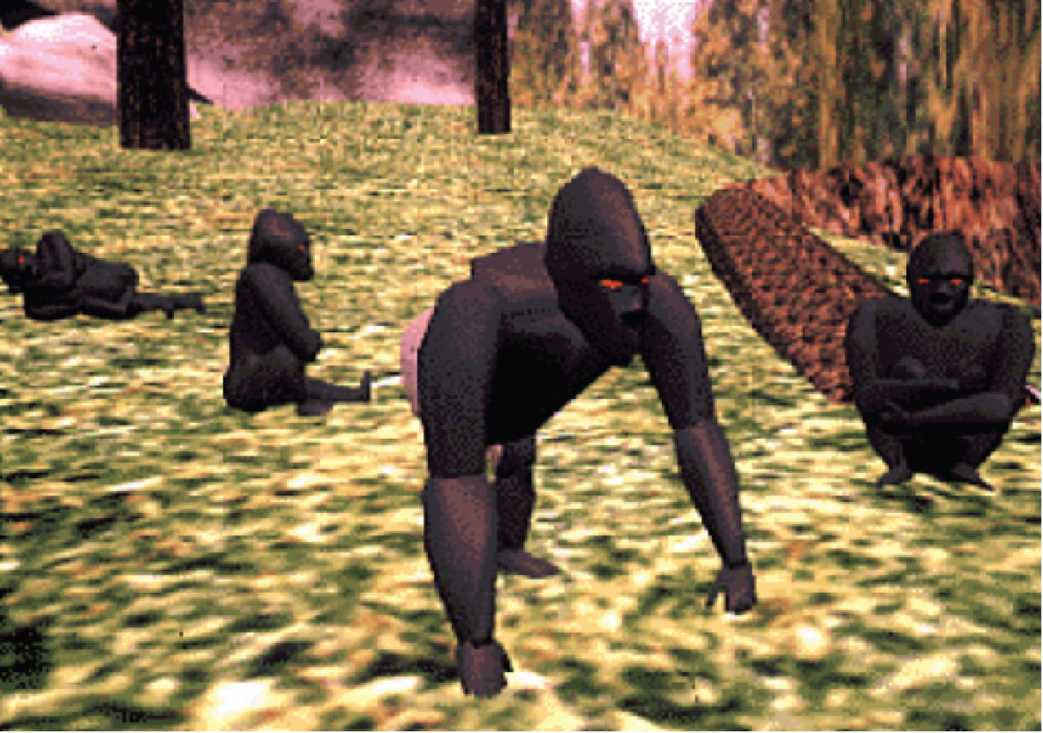
Virtual Gorilla Project

Slide 38
Research and design issues
Much research on how to design safe and realistic VRs to facilitate training
  e.g. flying simulators
  help people overcome phobias (e.g. spiders, talking in public)
Design issues
  how best to navigate through them (e.g. first versus third person)
  how to control interactions and movements (e.g. use of head and body movements)
  how best to interact with information (e.g. use of keypads, pointing, joystick buttons);
  level of realism to aim for to engender a sense of presence
Notes:
38

Slide 39
Which is the most engaging game of Snake?
Notes:
39
Realism versus abstraction?
One of the challenges facing interaction designers is whether to use realism or abstraction when designing an interface. This means designing objects either to (i) give the illusion of behaving and looking like real-world counterparts or (ii) appear as abstractions of the objects being represented. This concern is particularly relevant when implementing conceptual models that are deliberately based on an analogy with some aspect of the real world. For example, is it preferable to design a desktop to look like a real desktop, a virtual house to look like a real house, or a virtual terrain to look like a real terrain? Or, alternatively, is it more effective to design representations as simple abstract renditions, depicting only a few salient features?
One of the main benefits of using realism at the interface is that it can enable people to feel more comfortable when first learning an application. The rationale behind this is that such representations can readily tap into people’s understanding of the physical world. Hence, realistic interfaces can help users initially understand the underlying conceptual model. In contrast, overly schematic and abstract representations can appear to be too computer-like and may be off-putting to the newcomer. The advantage of more abstract interfaces, however, is that they can be more efficient to use. Furthermore, the more experienced users become, the more they may find comfortable interfaces no longer to their liking. A dilemma facing designers, therefore, is deciding between creating interfaces to make novice users feel comfortable (but more experienced users less comfortable) and designing interfaces to be effective for more experienced users (but maybe harder to learn by novices).

Slide 40
5. Information visualization
Computer-generated interactive graphics of complex data
Amplify human cognition, enabling users to see patterns, trends, and anomalies in the visualization (Card et al, 1999)
Aim is to enhance discovery, decision-making, and explanation of phenomena
Techniques include:
  3D interactive maps that can be zoomed in and out of and which present data via webs, trees, clusters, scatterplot diagrams, and interconnected nodes

Slide 41
Research and design issues
whether to use animation and/or interactivity
what form of coding to use, e.g. color or text labels
whether to use a 2D or 3D representational format
what forms of navigation, e.g. zooming or panning,
what kinds and how much additional information to provide, e.g. rollovers or tables of text
What navigational metaphor to use

